Slide 1


Slide 2
INTRODUCTION
Cricket is one of the most followed sports worldwide, generating massive amounts of data across teams, players, and matches. Analyzing this data provides valuable insights into player performance, team strengths, and match outcomes.

Slide 3
OBJECTIVE
Design a relational database for cricket tournaments covering Teams, Players, Matches, Batting and Bowling statistics.
Query the database to extract meaningful insights such as:
-Top batsmen and bowlers
-Match outcomes and winning patterns
-Player contributions by role and team
-Performance trends across ODI and T20 formats
Support analysis that helps in understanding team strategies, player consistency, and overall tournament highlights.

Slide 4
PROBLEM STATEMENT
Cricket tournaments involve a vast amount of structured and unstructured data such as player performances, team rankings, and match results.
Manually analyzing this data is time-consuming and may lead to overlooked insights.
There is a need for a system that can:
-Organize cricket data in a structured relational database.
-Efficiently retrieve and analyze performance metrics.
-Provide actionable insights for decision-making.

Slide 5

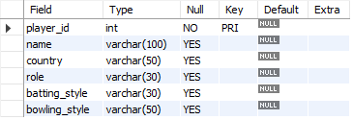
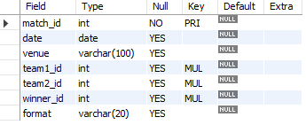
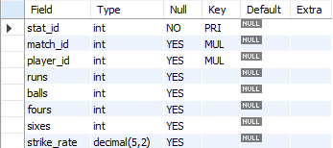
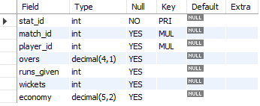
TABLES IN MY DATABASE
1.Teams Table
2.Players Table
3.Matches Table
4.Batting_Stats Table
5.Bowling_Stats Table

Slide 6
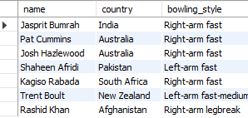
SCENARIOS
1. List all players who are bowlers.
OUTPUT:
SELECT name, country, bowling_style
FROM Players
WHERE role = 'Bowler';
Displays all players whose role is Bowler along with their country and bowling style.

Slide 7
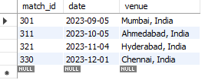
2.Show all matches played in India.
OUTPUT:
SELECT match_id, date, venueFROM MatchesWHERE venue LIKE '%India%';
Shows match_id, date, and venue for matches played in India.

Slide 8

3.Find all players from Australia who are all-rounders.
OUTPUT:
SELECT name
FROM Players
WHERE country = 'Australia' AND role = 'All-rounder';
Lists names of Australian players whose role is All-rounder.

Slide 9
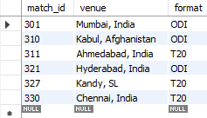
4. Display matches where Team India was the winner.
OUTPUT
SELECT match_id, venue, format
FROM Matches
WHERE winner_id = 1;
Shows match details (id, venue, format) where India was the winning team.

Slide 10
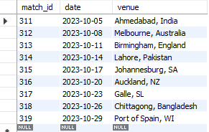
5. Get all T20 matches played in October 2023.
OUTPUT:
SELECT match_id, date, venue
FROM Matches
WHERE format = 'T20' AND date BETWEEN '2023-10-01' AND '2023-10-31';
Displays all T20 matches played in October 2023.

Slide 11
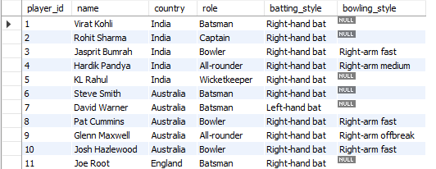
OUTPUT:
6. Update player roles promote Rohit Sharma to captain if needed.
UPDATE Players
SET role = 'Captain'
WHERE name = 'Rohit Sharma';
Changes Rohit Sharma’s role to Captain.

Slide 12
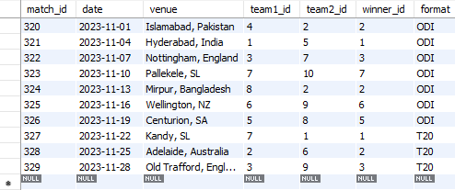
OUTPUT:
7.Delete a record of a cancelled match.
DELETE FROM Matches
WHERE match_id = 330;
Deletes the cancelled match with id 330.

Slide 13
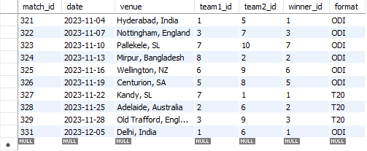
OUTPUT:
8. Insert a new match into the schedule.
INSERT INTO Matches VALUES
(331, '2023-12-05', 'Delhi, India', 1, 6, 1, 'ODI');
Adds a new match record (India vs NZ at Delhi).

Slide 14

9. Find venues that hosted more than 1 matches.
OUTPUT:
SELECT venue, COUNT(*) AS matches_count
FROM Matches
GROUP BY venue
HAVING COUNT(*) > 1;
Finds venues that hosted more than 2 matches.

Slide 15
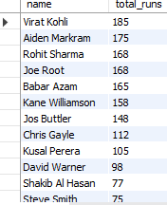
10. Find the total runs scored by each player.
OUTPUT:
SELECT p.name, SUM(b.runs) AS total_runs
FROM Batting_Stats b
JOIN Players p ON
b.player_id = p.player_id
GROUP BY p.name
ORDER BY total_runs DESC;
Calculates total runs scored by each player across all matches.

Slide 16

11.Get the highest individual score in the batting stats.
OUTPUT:
SELECT p.name, b.runs
FROM Batting_Stats b
JOIN Players p ON
b.player_id = p.player_id
ORDER BY b.runs DESC
LIMIT 1;';
Finds the highest score by a single player in one match.

Slide 17

12. Find average strike rate of Indian batsmen.
OUTPUT:
SELECT AVG(strike_rate) AS avg_sr
FROM Batting_Stats b
JOIN Players p ON
b.player_id = p.player_id
WHERE p.country = 'India';
Computes the average strike rate of all Indian batsmen.

Slide 18
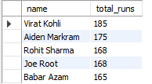
13. Show top 5 run scorers overall.
OUTPUT:
SELECT p.name, SUM(b.runs) AS total_runs
FROM Batting_Stats b
JOIN Players p ON
b.player_id = p.player_id
GROUP BY p.name
ORDER BY total_runs DESC
LIMIT 5;
Shows the top five players with the most total runs.

Slide 19
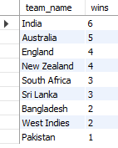
14.Count how many matches each team has won.
OUTPUT:
SELECT t.team_name, COUNT(*) AS wins
FROM Matches m
JOIN Teams t ON
m.winner_id = t.team_id
GROUP BY t.team_name
ORDER BY wins DESC;
Counts how many matches each team has won.

Slide 20
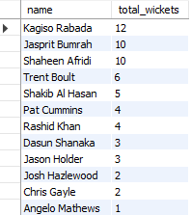
15.Show total wickets taken by each bowler.
OUTPUT:
SELECT p.name, SUM(bw.wickets) AS total_wickets
FROM Bowling_Stats bw
JOIN Players p ON
bw.player_id = p.player_id
GROUP BY p.name
ORDER BY total_wickets DESC;
Displays bowlers and their total wickets taken across matches.

Slide 21
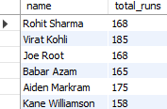
16.Find players who scored more than 150 runs overall.
OUTPUT:
SELECT p.name, SUM(b.runs) AS total_runs
FROM Batting_Stats b
JOIN Players p ON
b.player_id = p.player_id
GROUP BY p.name
HAVING SUM(b.runs) > 150;
Lists players whose total runs exceed 150.

Slide 22

17.Show teams with more than 3 wins.
OUTPUT:
SELECT t.team_name, COUNT(*) AS wins
FROM Matches m
JOIN Teams t ON
m.winner_id = t.team_id
GROUP BY t.team_name
HAVING COUNT(*) > 3;
Finds teams that have won more than 3 matches.

Slide 23
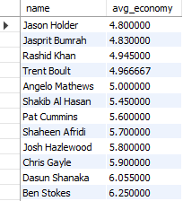
18.Find average economy rate of each bowler.
OUTPUT:
SELECT p.name, AVG(bw.economy) AS avg_economy
FROM Bowling_Stats bw
JOIN Players p ON
bw.player_id = p.player_id
GROUP BY p.name
ORDER BY avg_economy ASC;
Calculates the average economy rate for each bowler.

Slide 24

19.List players who hit more than 10 sixes in total.
OUTPUT:
SELECT p.name, SUM(b.sixes) AS total_sixes
FROM Batting_Stats b
JOIN Players p ON b.player_id = p.player_id
GROUP BY p.name
HAVING SUM(b.sixes) >5;
Lists players who have hit more than 5 sixes in total.

Slide 25

20.Find the player who scored the highest runs in a single match.
OUTPUT:
SELECT p.name, b.runs
FROM Batting_Stats b
JOIN Players p ON b.player_id = p.player_id
WHERE b.runs = (
SELECT MAX(runs)
FROM Batting_Stats
);
Finds the player with the single highest score across matches.

Slide 26

21.Find the bowler with the best economy in ODI matches.
OUTPUT:
SELECT p.name, bw.economy
FROM Bowling_Stats bw
JOIN Matches m ON bw.match_id = m.match_id
JOIN Players p ON
bw.player_id = p.player_id
WHERE m.format = 'ODI'
ORDER BY bw.economy ASC
LIMIT 1;
Retrieves the bowler with the best economy rate in ODI matches.

Slide 27
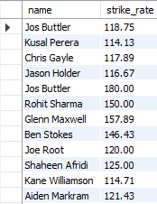
22.Get players whose strike rate is above the team average.
OUTPUT:
SELECT p.name, b.strike_rate
FROM Batting_Stats b
JOIN Players p ON b.player_id = p.player_id
WHERE b.strike_rate > (
SELECT AVG(strike_rate) FROM Batting_Stats
););
Lists players whose strike rate is above the overall average.

Slide 28

23.Find matches where the winning team scored more than 180 runs.
OUTPUT:
SELECT DISTINCT m.match_id, m.venue, t.team_name
FROM Matches m
JOIN Teams t ON m.winner_id = t.team_id
JOIN Batting_Stats b ON
m.match_id = b.match_id
GROUP BY m.match_id, t.team_name, m.venue
HAVING SUM(b.runs) >= 180;
Shows matches where the winning team’s total runs were at least 180.

Slide 29

24.List teams that have never won a match.
OUTPUT:
SELECT team_name
FROM Teams
WHERE team_id NOT IN (
SELECT DISTINCT winner_id FROM Matches );
Lists teams that have never won a match.

Slide 30
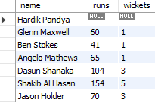
25.Show batting + bowling contributions of all-rounders in a single query.
OUTPUT:
SELECT p.name, SUM(b.runs) AS runs, SUM(bw.wickets) AS wickets
FROM Players p
LEFT JOIN Batting_Stats b ON p.player_id = b.player_id
LEFT JOIN Bowling_Stats bw ON p.player_id = bw.player_id
WHERE p.role = 'All-rounder'
GROUP BY p.name;
Shows all-rounders’ total runs and wickets.

Slide 31
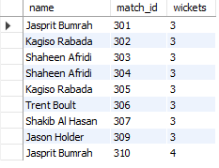
26.List bowlers who dismissed at least 3 players in a match..
OUTPUT:
SELECT p.name, bw.match_id, bw.wickets
FROM Bowling_Stats bw
JOIN Players p ON bw.player_id = p.player_id
WHERE bw.wickets >= 3;
Lists bowlers who took at least 3 wickets in a match.

Slide 32
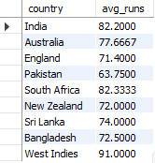
27.Compare average runs per player per team.
OUTPUT:
SELECT p.country, AVG(b.runs) AS avg_runs
FROM Players p
JOIN Batting_Stats b ON
p.player_id = b.player_id
GROUP BY p.country;
Calculates average runs per player per team.

Slide 33
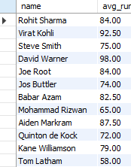
28.Find average runs, rounded to 2 decimals
OUTPUT:
SELECT p.name, ROUND(AVG(b.runs), 2) AS avg_runs
FROM Batting_Stats b
JOIN Players p ON
b.player_id = p.player_id
GROUP BY p.name;;
Shows average runs per player, rounded to 2 decimals.

Slide 34
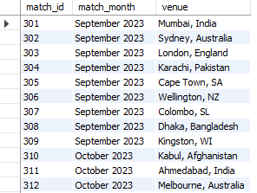
29.Extract month from match date
OUTPUT:
SELECT match_id, DATE_FORMAT
(date, '%M %Y') AS match_month, venue
FROM Matches;
Converts date into “September 2023” style format.

Slide 35
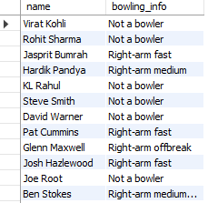
30.COALESCE for missing bowling styles
OUTPUT:
SELECT name, COALESCE(bowling_style, 'Not a bowler') AS bowling_info
FROM Players;
Replaces NULL bowling_style with “Not a bowler”.

Slide 36
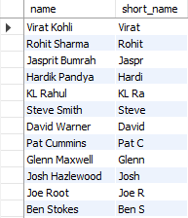
31.Use SUBSTRING to shorten player names
OUTPUT:
SELECT name, SUBSTRING(name, 1, 5) AS short_name
FROM Players;
Shows first 5 letters of each player’s name.

Slide 37
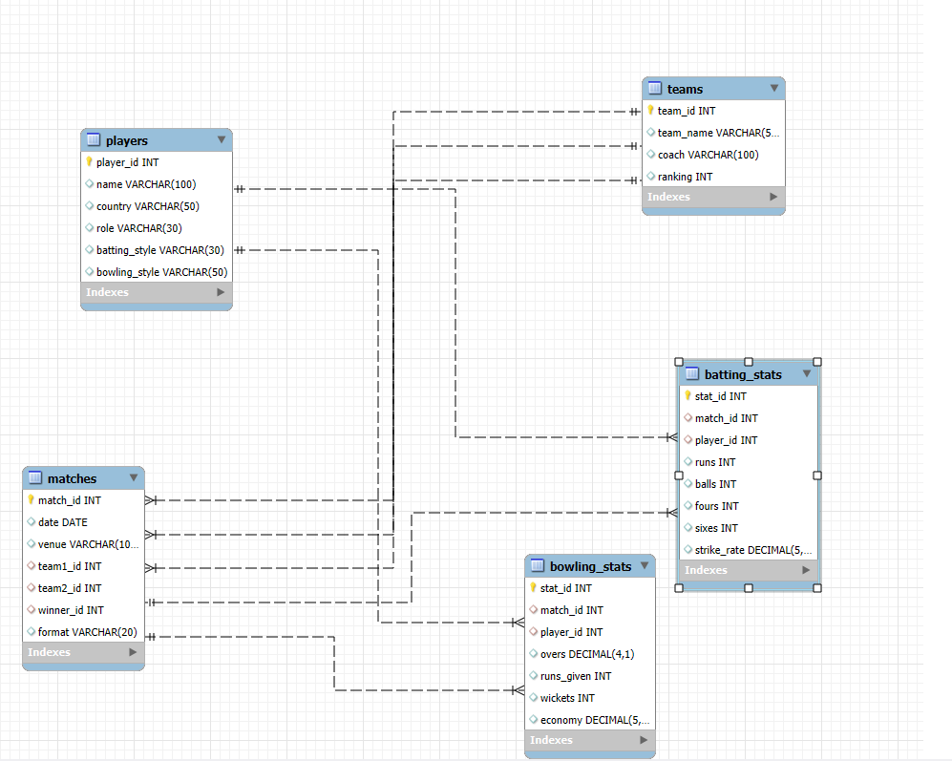
ER Diagram

Slide 38
CONCLUSION:
This project successfully demonstrates how SQL can be used to design, create, and manage a relational database for the game of cricket.
We created multiple interconnected tables such as Teams, Players, Matches, Batting_Stats, and Bowling_Stats, and applied Primary Keys and Foreign Keys to ensure data consistency and integrity, through various SQL queries, we retrieved both detailed and summarized insights, proving how relational databases can efficiently organize and analyze cricket data. These queries included team-wise statistics, player performances, match outcomes, and comparative analyses between different entities.
The Entity–Relationship (ER) Diagram clearly represents the relationships between teams, players, matches, and their statistics, making the system easy to understand and use.
Overall, this project highlights the importance of database management in sports analytics -enabling efficient data storage, ensuring accuracy, and providing fast retrieval for reports, insights, and decision-making.

Slide 39
THANK YOU

